Slide 1
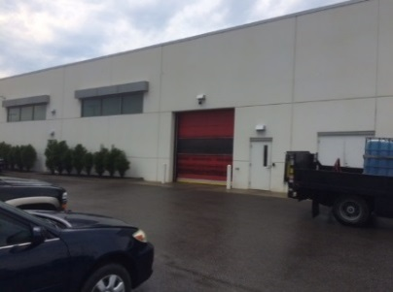
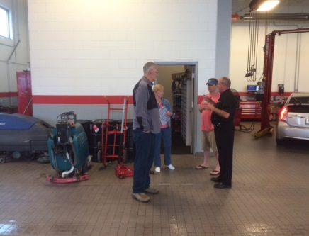
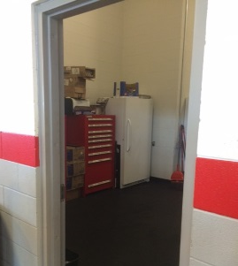
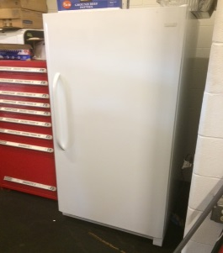
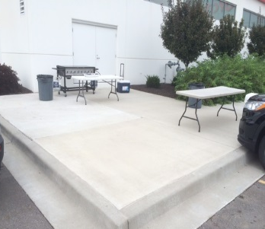
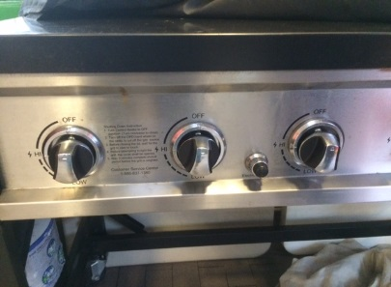
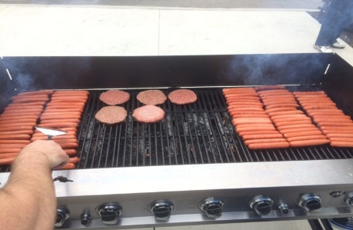
KCGA Volunteer Fundraiser @ Hendrick Toyota 9505 W. 67th Street, Merriam, KS (I-35 & 67th St) Second & Fourth Saturday of the month from June 11th, 2016 through August 27th, 2016 From 9:30 a.m. to approx. 12:30 or 1:00 p.m. Park on south side of main Toyota building, right before the Lexus building Dealership General Manager & Contact: Randy C. – (816) 714-9169
GA Contact
Brian J. (913) 940-5427
1
2
3
4
5
6
Contact Randy C. to let him know the volunteers have arrived.
Go to door on south end of main building.
The supplies and grill are located in the storage room inside this door.
Burgers and Hot Dogs will be frozen in the freezer. Buns, chips, condiments and cooking supplies will be visible near the fridge.
The grill should already be out and setup, along with a serving table and one smaller staging table. You can re-arrange these as needed so the smoke blows away from the grill. If these are not setup when you arrive, they will likely be inside near the storage room and Hendrick personnel can help bring them outside and set them up.
The grill should have full propane tanks and has starter buttons and gas controls. Take the frozen product and place in tins on the staging table to thaw out. Turn burners to high and let grill warm up, then spray with non-stick spray.
Use entire cooking surface (recommended layout in pic), we will be feeding 125-150 people. As food is cooked, place in foil-lined tins, cover tins with foil, and set out on serving table with buns, condiments, etc. Begin putting out food once you have a full tin of burgers and hot dogs (around 10:30-10:45). Cook all food until it is gone and completely fill serving area.
When all food is cooked, you are done! Turn off burners and let Randy know you are finished. Hendrick personnel will put away grill, tables, supplies, etc. They will also take remaining cooked food inside.
Please eat anytime while you are there!

